Slide 1

Introduction to Comparative Effectiveness and Patient-Centered Outcomes Research
Maria E. Suarez-Almazor, MD, PhD
Barnts Family Distinguished Professor
Department of Health Services Research
University of Texas MD Anderson Cancer Center
msalmazor@mdanderson.org

Slide 2
Overview
Session 1
Definitions
Rationale
Principles
Session 2
Basic methods

Slide 3
CER: Comparative Effectiveness Research
PCOR: Patient-Centered Outcomes Research
RWE: Real-World Evidence

Slide 4
Comparative Effectiveness Research (CER)
Patient Centered Outcomes Research Institute (2010) pcori.org
Aim: to inform healthcare decisions by providing evidence on the benefits and harms of different alternatives
CER compares the effectiveness of two or more interventions or approaches to health care, examining their risks and benefits
CER findings assist clinicians, patients, and other stakeholders in making informed decisions that improve health care
It can both validate a particular intervention and identify which treatments best meet a certain population’s needs
Difference between efficacy & effectiveness

Slide 5
Efficacy vs Effectiveness
Efficacy
Performance of an intervention under ideal circumstances
CAN it work?
Effectiveness
Performance of an intervention in the ‘real-world’, in the community
DOES it work?

Slide 6
Community Effectiveness
Efficacy x
Access x
Appropriate diagnosis x
Appropriate/actual prescription x
Adherence to treatment

Slide 7
Community Effectiveness
 | Efficacy | Access | Dx | Rx | Adherence | EFFECTIVENESS
Intervention A | 48% | 80% | 85% | 85% | 70% | 19%

Slide 8
Community Effectiveness
 | Efficacy | Access | Dx | Rx | Adherence | EFFECTIVENESS
Intervention A | 48% | 80% | 85% | 85% | 70% | 19%
New Intervention | 60% | 80% | 85% | 85% | 70% | 24%

Slide 9
Community Effectiveness
 | Efficacy | Access | Dx | Rx | Adherence | EFFECTIVENESS
Intervention A | 48% | 80% | 85% | 85% | 70% | 19%
New Intervention | 60% | 80% | 85% | 85% | 70% | 24%
Intervention A + change in other factors | 48% | 90% | 90% | 90% | 80% | 28%

Slide 10
Comparative Effectiveness Research and Real-World Evidence
Effectiveness: what happens in the “real world” vs. in a highly controlled study environment
RWE: Real-world evidence
Comparative: New interventions developed at exponential rates, impossible to have trials with head-to-head comparisons
Compare available alternatives with respect to:
Value: Benefits vs. Harms/Costs
Applicability to different populations
Feasibility

Slide 11
Two Dimensions to CER: Effectiveness & Comparisons
Simple RCT
 | Comparative Research in Real World Setting
Efficacy
Effectiveness
Placebo
Single drug comparator
Real-world comparisons
or usual care

Slide 12
Bird’s Eye View

Slide 13
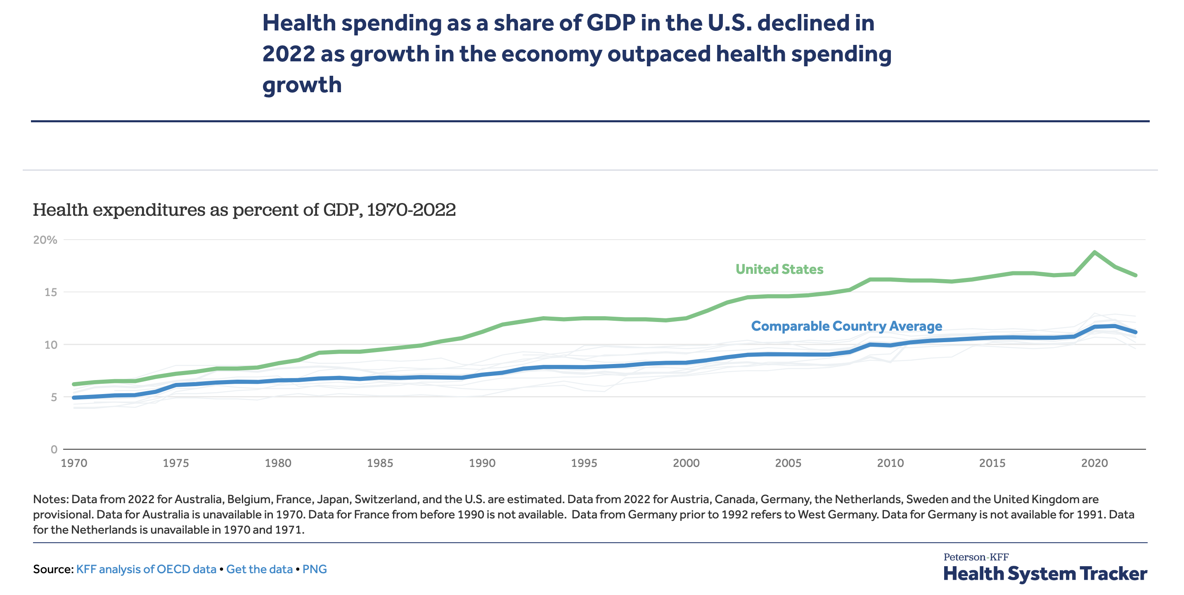
17.3%
~ 11%

Slide 14
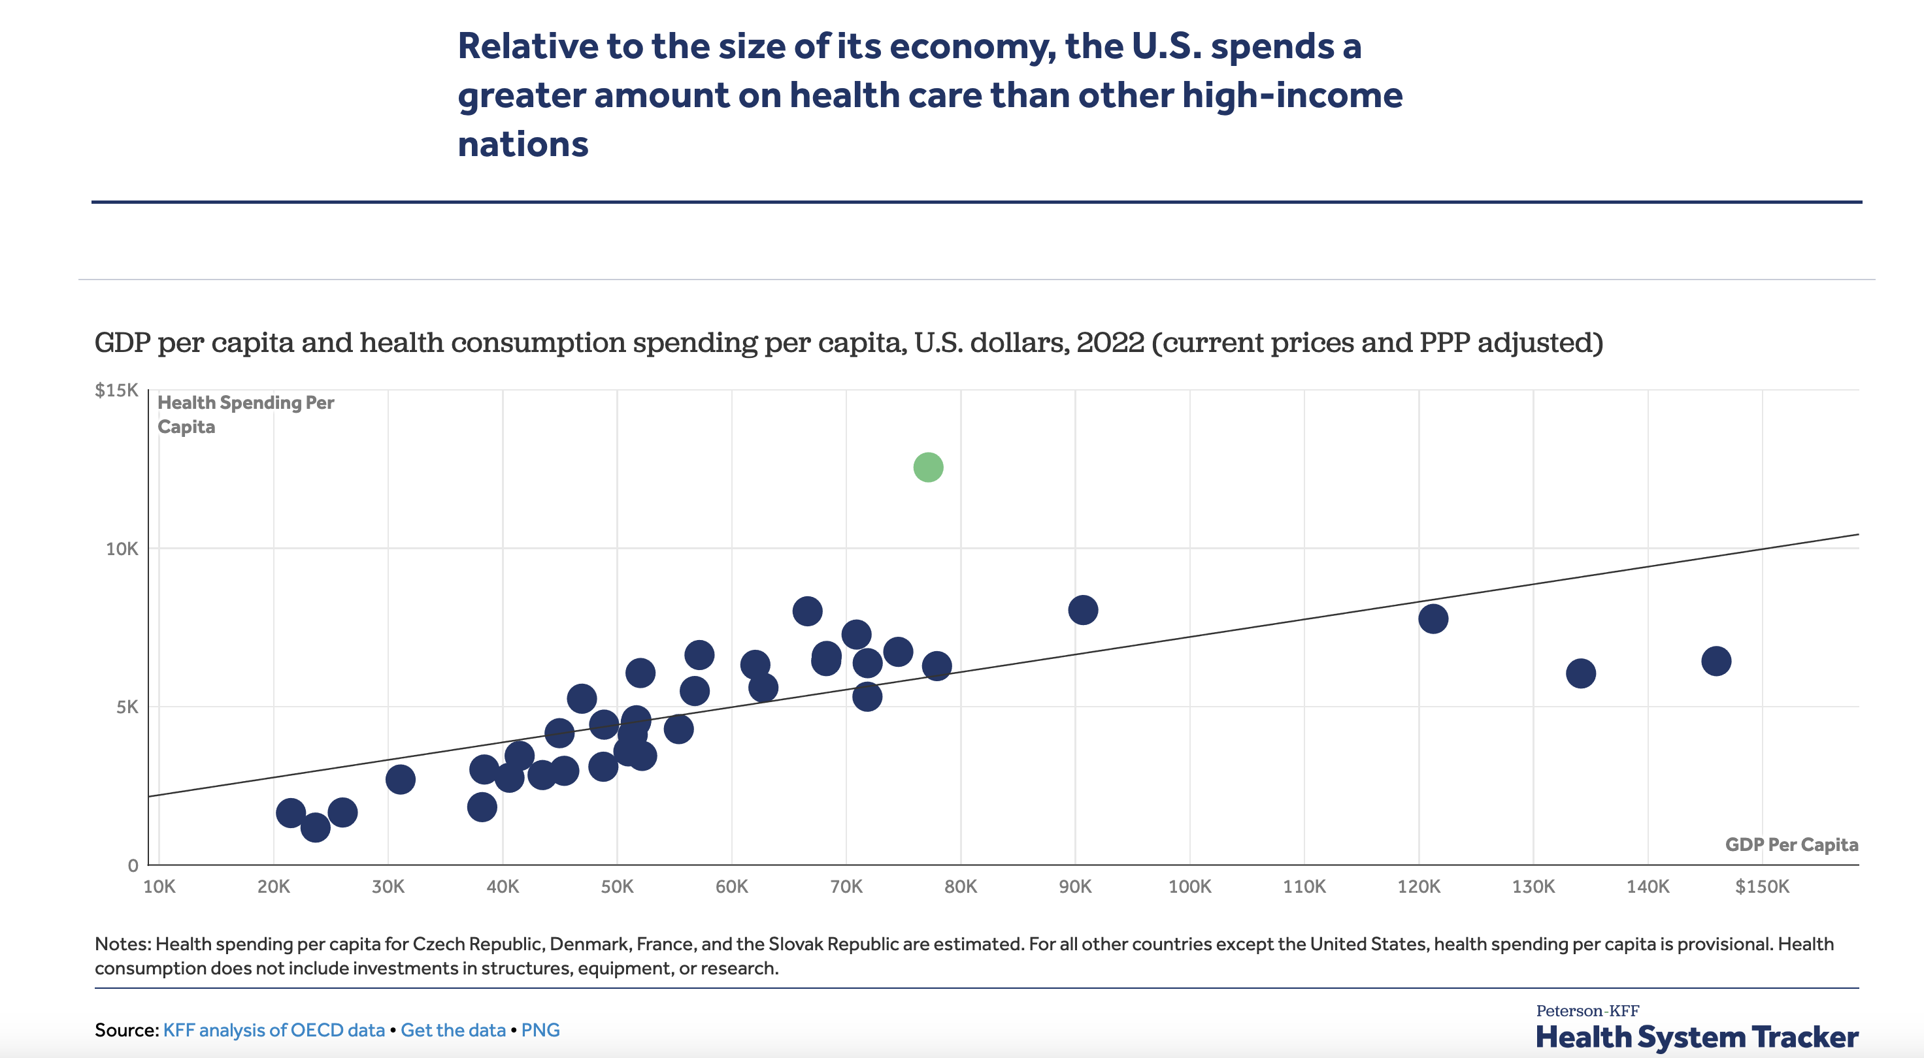
GDP per capita USA # 8

Slide 15
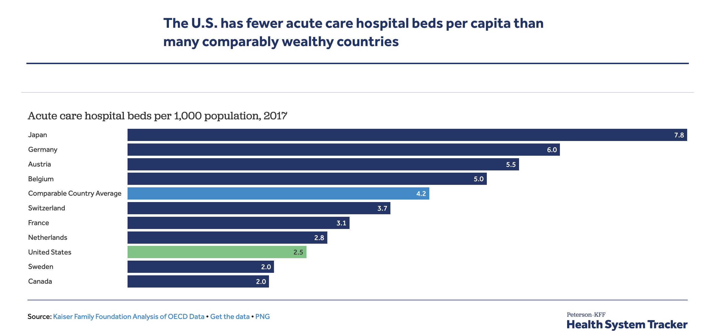

Slide 16
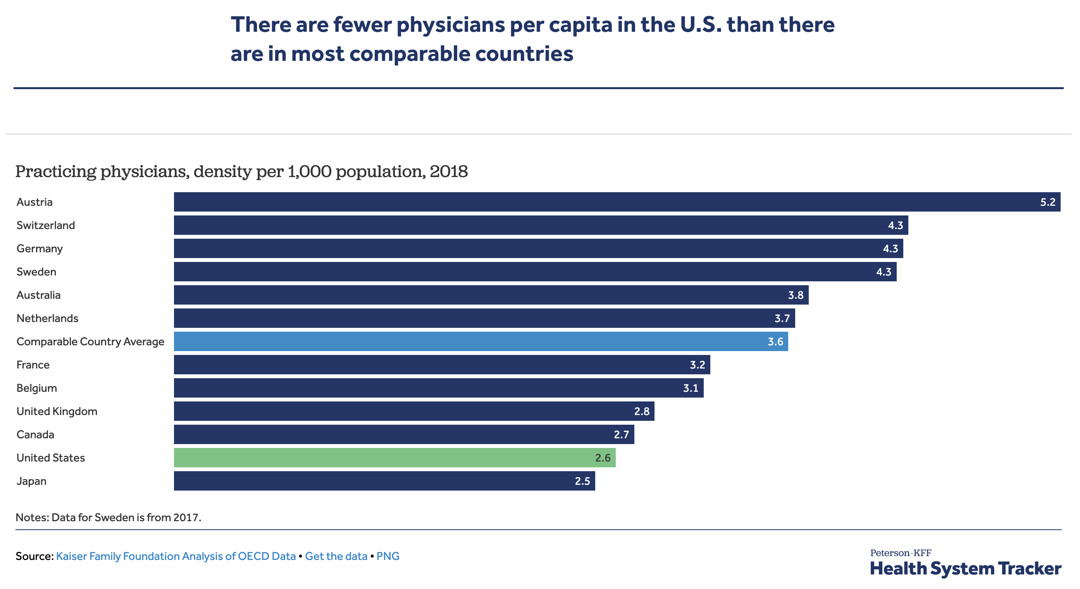

Slide 17
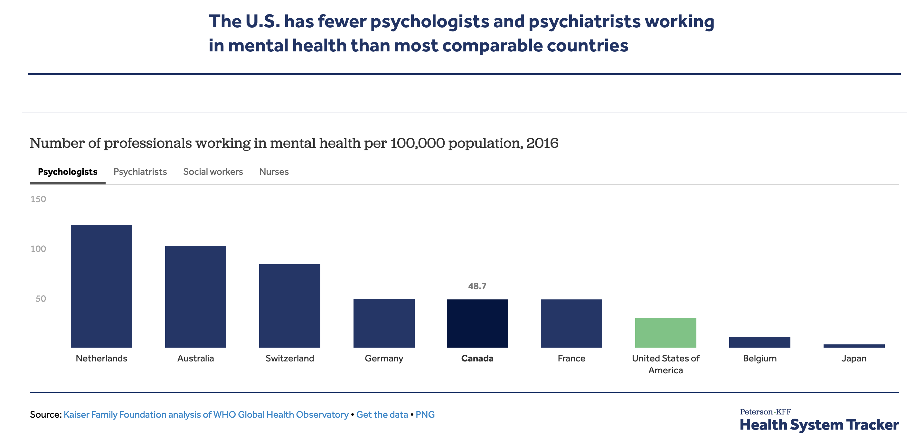

Slide 18
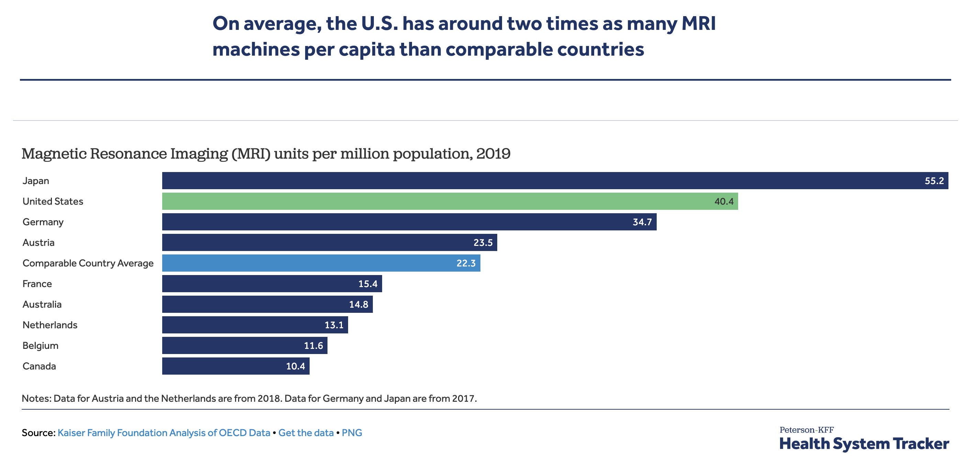

Slide 19
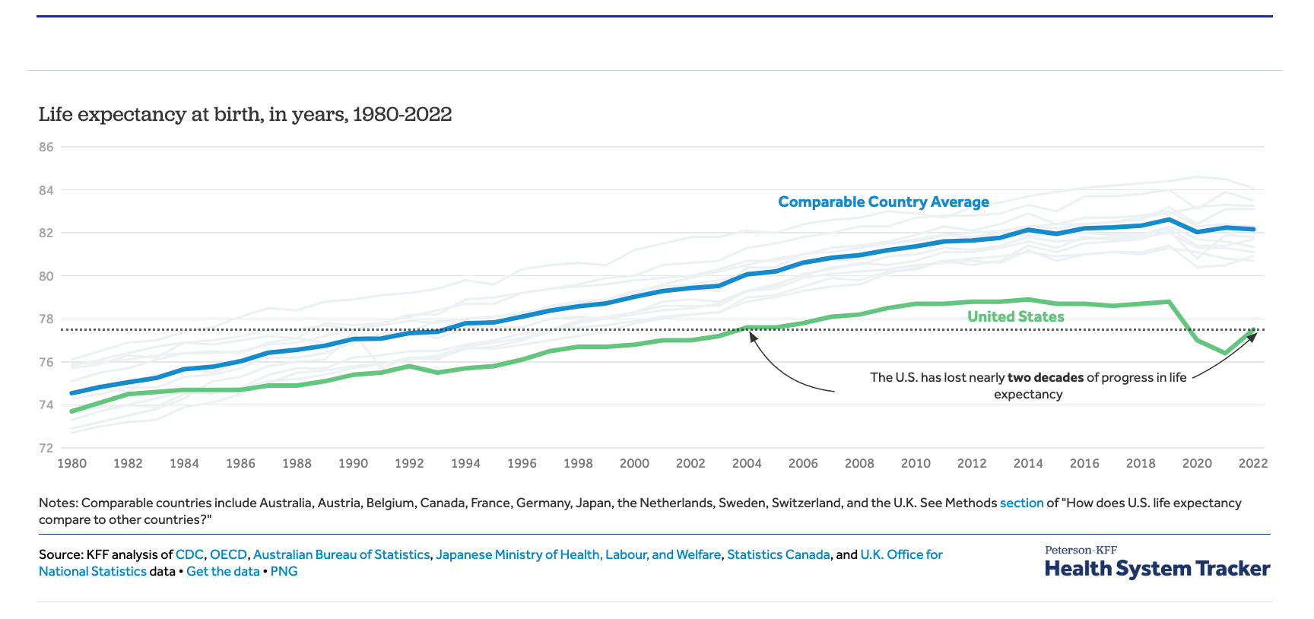
Life Expectancy at Birth

Slide 20
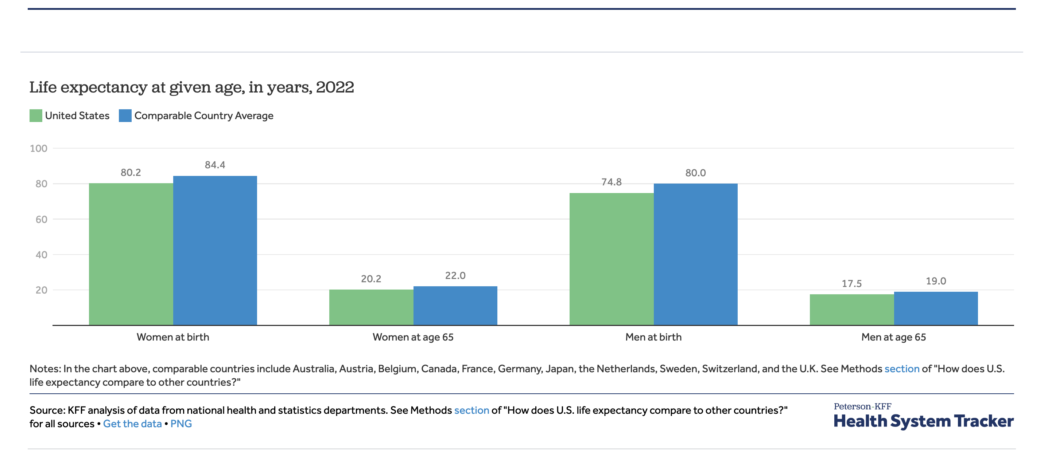

Slide 21
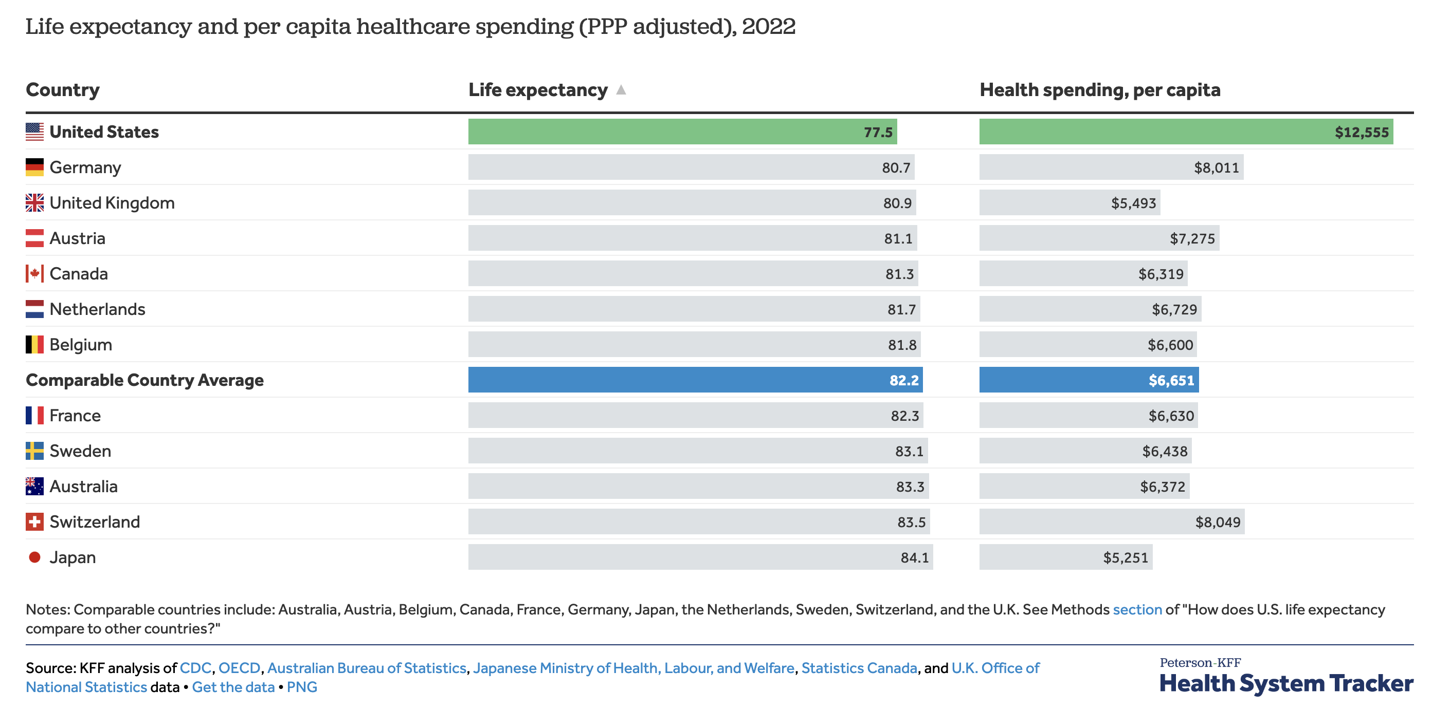
PPP adjusted

Slide 22
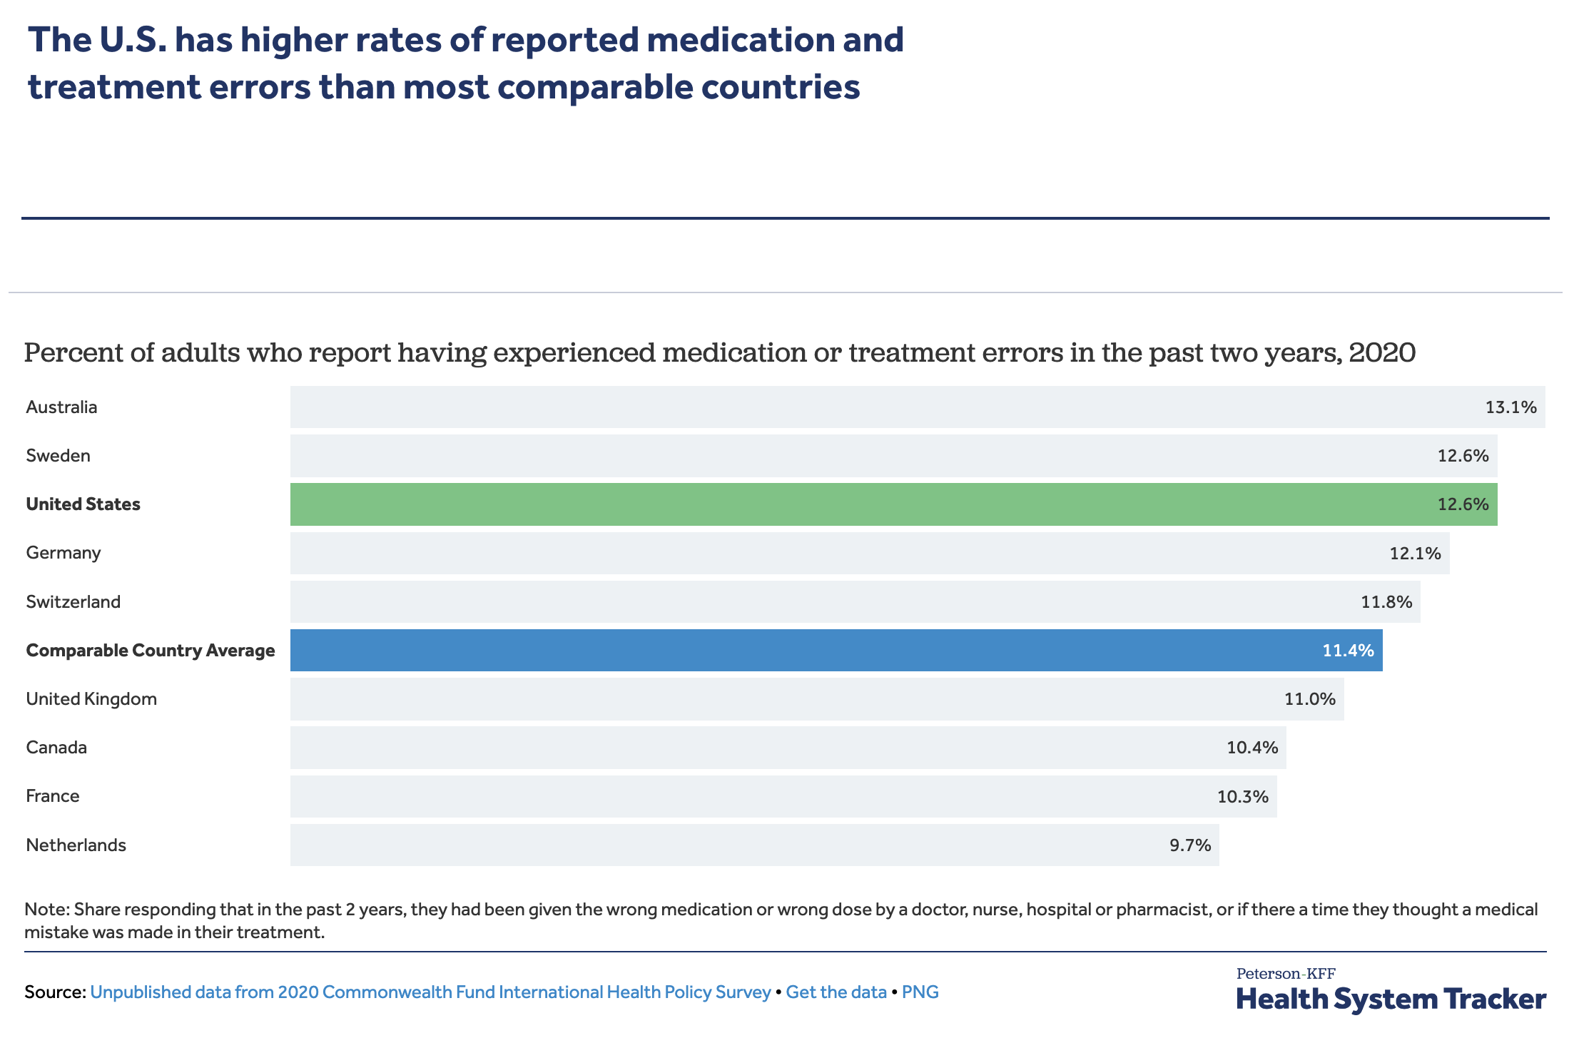

Slide 23
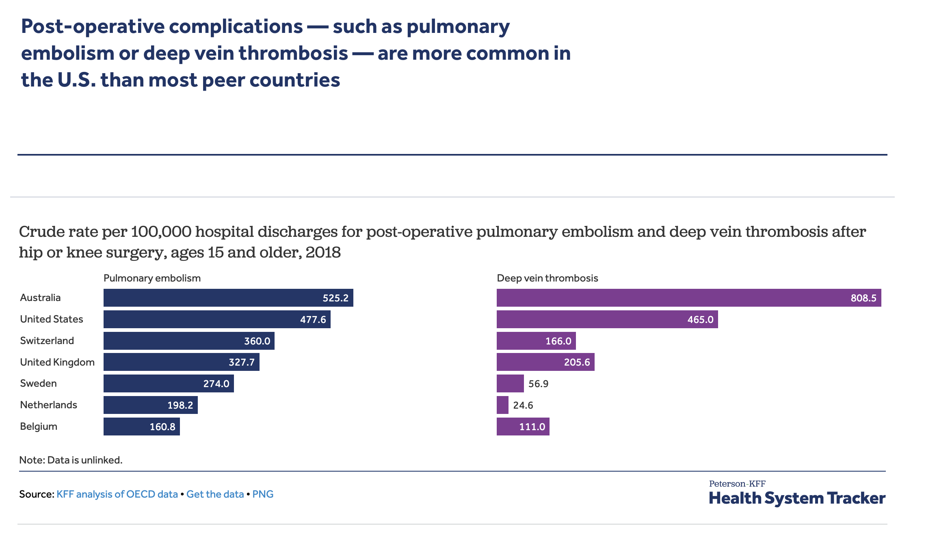

Slide 24
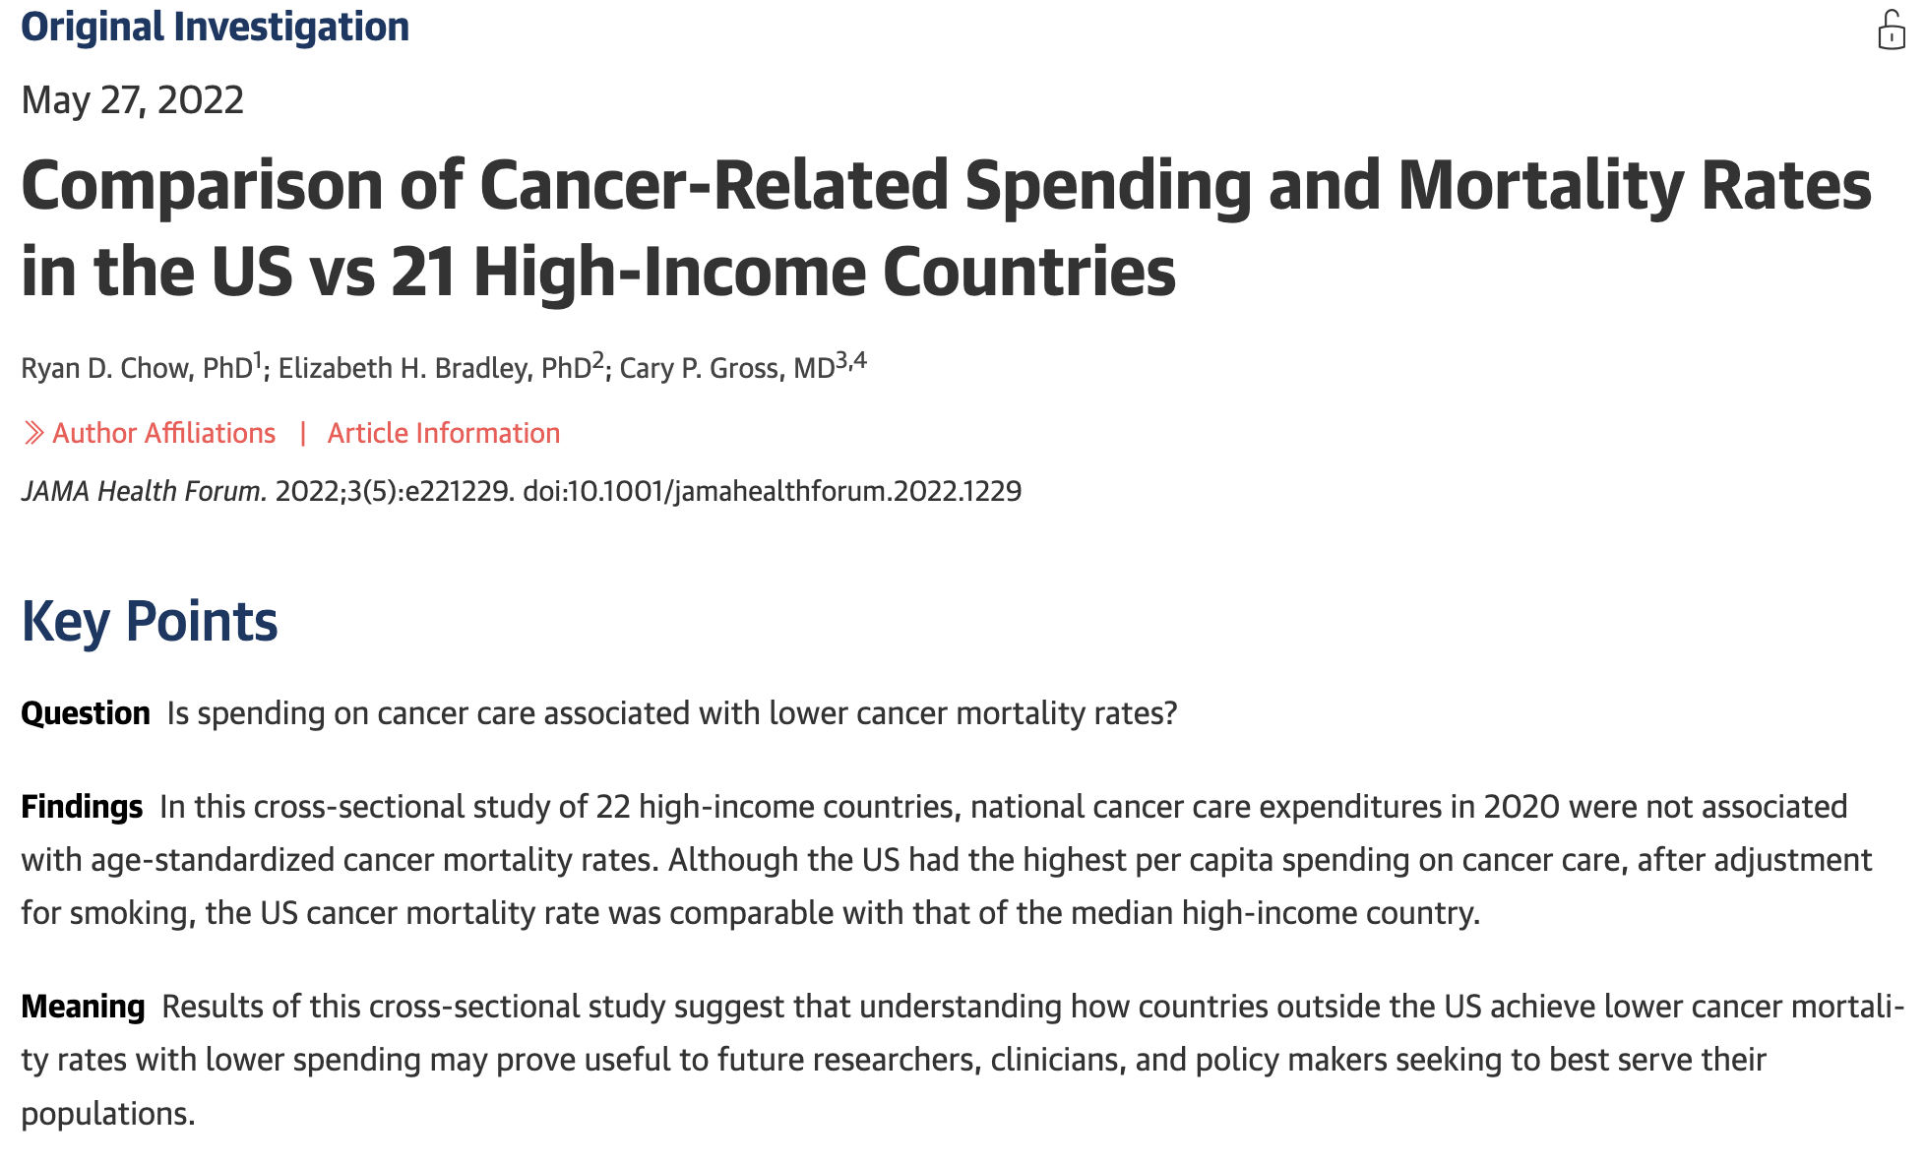
How Do we Do with Cancer?

Slide 25
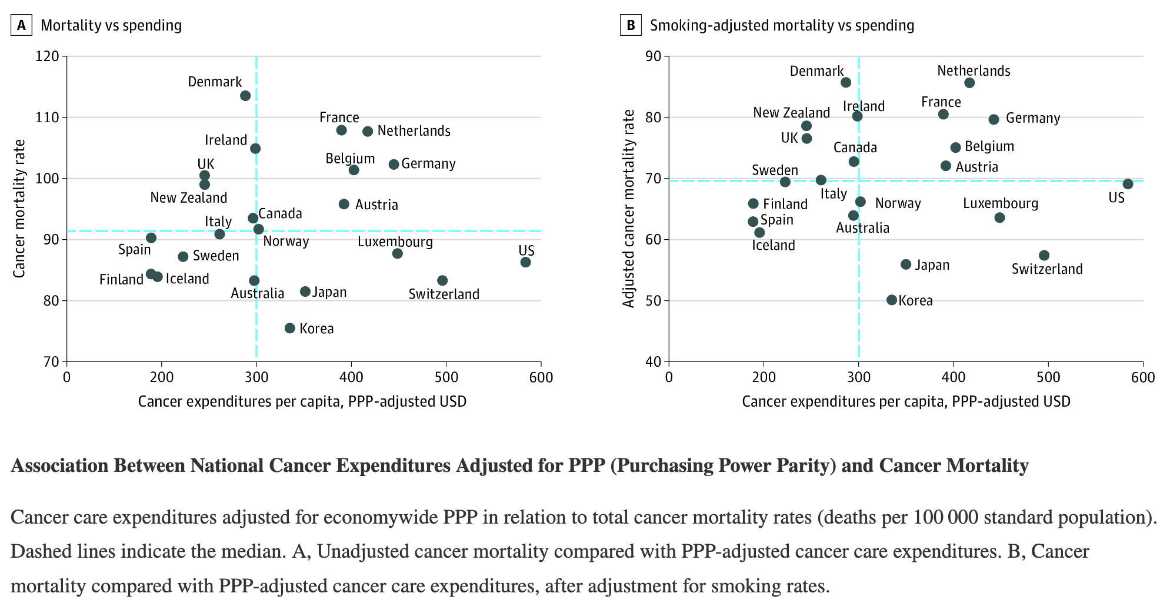
Chow RD, Bradley EH, Gross CP. Comparison of Cancer-Related Spending and Mortality Rates in the US vs 21 High-Income Countries. JAMA Health Forum. 2022 May 27;3(5):e221229. doi: 10.1001/jamahealthforum.2022.1229. PMID: 35977250; PMCID: PMC9142870.

Slide 26
Better Bang for Our Buck
with
Outcomes that Consider
Patient Well-being and Preferences

Slide 27
Why do we need Comparative Effectiveness Research (CER)?
Lack of evidence on “head-to-head” comparisons of alternative interventions
Too many interventions to compare
Inappropriate health care technologies use (i.e., over-use, under-use, and improper use)
Large variations in management
Best comparison is ‘standard of care’
Inconsistent, insufficient ability to conduct subgroup analyses
Increasing health care costs (elephant in the room)
Development and implementation of Clinical Practice Guidelines
Adapted from: Agency for Healthcare Research and Quality. http://effectivehealthcare.ahrq.gov/index.cfm/what-is-comparative-effectiveness-research1/

Slide 28

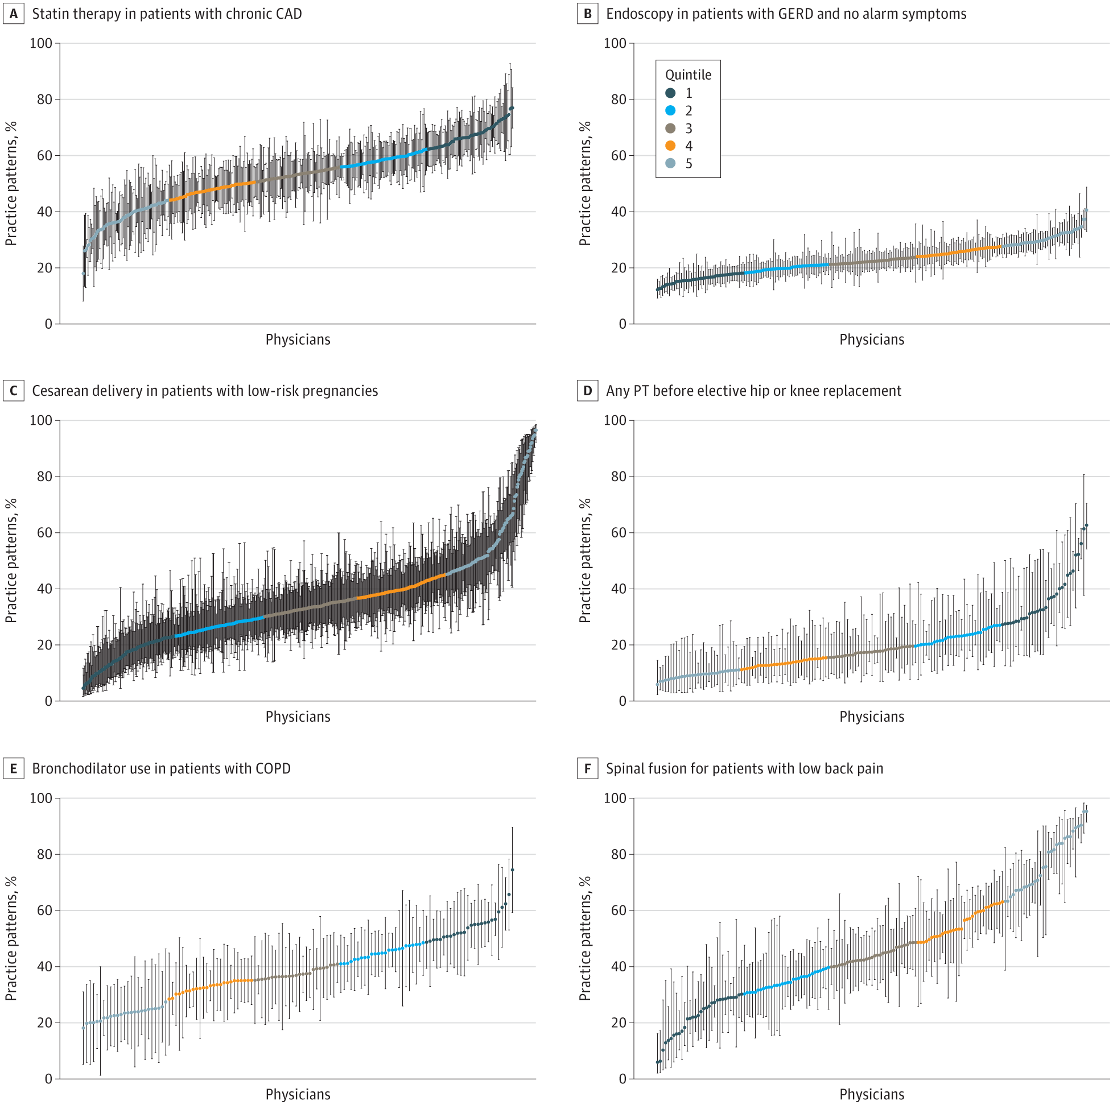
From: Physician Practice Pattern Variations in Common Clinical Scenarios Within 5 US Metropolitan Areas
JAMA Health Forum. 2022;3(1):e214698. doi:10.1001/jamahealthforum.2021.4698
5 metropolitan areas
>8700 physicians from different specialties
Physician-Level Variations in Practice Patterns Across 6 Clinical Scenarios in the South Central Metropolitan Statistical Area
Quintile 1 (dark blue) represents, on average, more appropriate care, and quintile 5 denotes less appropriate care on average.
Statin therapy in patients with chronic coronary artery disease (CAD) (A), endoscopy in patients with gastroesophageal reflux disease (GERD) and no alarm symptoms (B), caesarean delivery in patients with low-risk pregnancies (C), any physical therapy (PT) prior to elective hip or knee replacement (D), use of bronchodilator in patients with chronic obstructive pulmonary disease (COPD) (E), and spinal fusion for patients with low back pain (F).
Each physician is denoted by a data point and vertical 95% CI.

Slide 29
Multiple Alternatives for Treatment Example: Rheumatoid Arthritis
Disease-Modifying Antirheumatic Drugs (DMARDs)
Corticosteroids | Conventional Synthetic csDMARDs | Biologic bDMARD | Targeted synthetic tsDMARDs (JAK inhibitors)
 | Methotrexate | TNF inhibitors (5) | Tofacitinib
 | Leflunomide | IL6 inhibitors (2) | Baricitinib
 | Hydroxychloroquine | CTLA4 agonists (1) | Upadacitinib
 | Sulfasalazine | CD20 inhibitors (1)
Some of these agents can be used in combination
There will never be a trial that compares head-to head all single agents and combinations
Risks and benefits may vary across populations (e.g. young vs old)
Other methods needed to assess comparative effectiveness

Slide 30
Patient Centered Outcomes Research (PCOR)
Outcomes that matter to people
PCOR helps people make informed health care decisions and allows their voice to be heard in assessing the value of health care options
Answers patient-focused questions:
Given my personal characteristics, conditions and preferences, what should I expect will happen to me?
What are my options and what are the benefits and harms of those options?
What can I do to improve the outcomes that are most important to me?
How can the health care system improve my chances of achieving the outcomes I prefer?

Slide 31
Is all CER patient-centered?
Not necessarily, in order for CER to be patient-centered, it needs to answer patient-focused research questions

Slide 32
To respond to patients’ need, CER & PCOR:
Assess the benefits and harms of various alternative interventions to inform decision making, highlighting comparisons and outcomes that matter to people
Inclusive of an individual's preferences, focusing on outcomes that people notice and care about
Incorporate a wide variety of settings and diversity of participants to address individual differences and barriers to implementation and dissemination
Investigate optimizing outcomes while addressing burden to individuals, resources, and other stakeholder perspectives

Slide 33
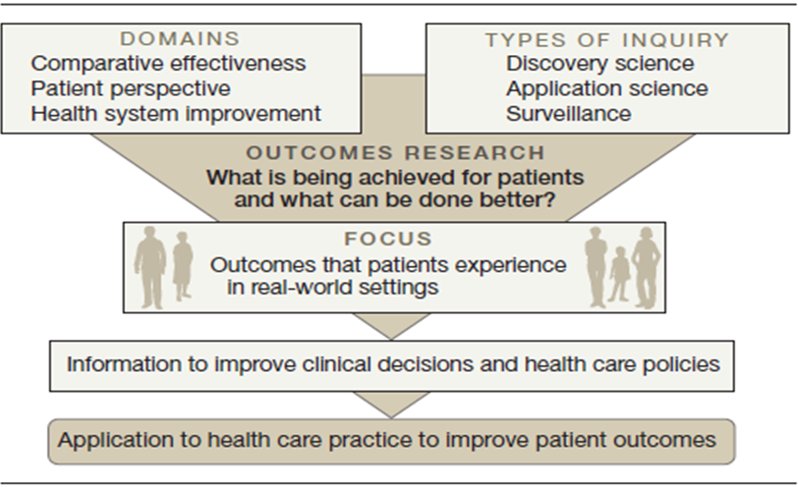
CER Framework
Krumholz HM. Real-world imperative of outcomes research. JAMA 2011:306(7):754-5

Slide 34
PCORI Methodology Standards
Specific recommendations for researchers that designate requirements for PCOR best practices
Provide guidance in areas where there are either substantial deficiencies or inconsistences
How research question is selected, formulated, and addressed, and how the findings are reported
Designed to promote transparency
How properly to communicate-in both study protocols and published reports-exactly what was planned and what was done
Regularly updated
https://www.pcori.org/research-related-projects/about-our-research/research-methodology/pcori-methodology-standards

Slide 35
PCORI Methodology Standards
Guidance in 17 areas, for a total of 67 standards
Cross-Cutting Standards for Patient-Centered Comparative Clinical Effectiveness Research (CER)* 1. Formulating Research Questions 2. Patient Centeredness 3. Data Integrity and Rigorous Analyses 4. Preventing and Handling Missing Data 5. Heterogeneity of Treatment Effects (HTE) 6. Usual Care (UC) as a Comparator
Source: PCORI methodology report, November 2013

Slide 36
Standards for Specific Study Designs and Methods
7. Standards for Data Registries 8. Standards for Data Networks as Research-Facilitating Structures 9. Standards for Causal Inference Methods 10. Standards for Adaptive and Bayesian Trial Designs 11. Standards for Studies of Medical Tests 12. Standards for Systematic Reviews 13. Standards on Research Designs Using Clusters 14. Standards for Studies of Complex Interventions 15. Standards for Qualitative Methods 16. Standards for Mixed Methods Research 17. Standards for Individual Participant-Level Data Meta-Analysis (IPD-MA)

Slide 37
How to Develop a Research Question: PICOTS
P Population (who)
I Intervention (what are we examining)
C Comparator (compared to)
O Outcome (what happens)
T Timing (when)
S Setting (where)

Slide 38
PCORI Standards for Formulating Research Questions
Identify gaps in evidence
Develop a formal study protocol
Identify specific populations and health decisions affected by the research
Identify and assess participant subgroups
Select appropriate interventions and comparators
Measure outcomes that people representing the population of interest notice and care about

Slide 39
PCORI Standards for Patient Centeredness
Engage people representing the population of interest and other relevant stakeholders in ways that are appropriate and necessary in a given research context
Identify, select, recruit, and retain study participants representative of the spectrum of the population of interest and ensure that data are collected thoroughly and systematically from all study participants
Use patient-reported outcomes when patients or people at risk of a condition are the best source of information for outcomes of interest
Support dissemination and implementation of study results

Slide 40
References
Schaumberg DA, McDonald L, Shah S, Stokes M, Nordstrom BL, Ramagopalan SV. Evaluation of comparative effectiveness research: a practical tool. J Comp Eff Res. 2018 May;7(5):503-515. doi: 10.2217/cer-2018-0007. Epub 2018 Feb 21. PMID: 29463115.
Djulbegovic B, Guyatt GH. Progress in evidence-based medicine: a quarter century on. Lancet. 2017 Jul 22;390(10092):415-423. doi: 10.1016/S0140-6736(16)31592-6. Epub 2017 Feb 17. PMID: 28215660.
Vandenbroucke JP, Pearce N. From ideas to studies: how to get ideas and sharpen them into research questions. Clin Epidemiol. 2018 Mar 6;10:253-264. doi: 10.2147/CLEP.S142940. PMID: 29563838; PMCID: PMC5846748.
Methodological Standards and Patient-Centeredness in Comparative Effectiveness Research The PCORI Perspective. JAMA. 2012;307(15):1636-1640.
https://www.pcori.org/research-related-projects/about-our-research/research-methodology/pcori-methodology-standards

